Slide 1


Slide 2
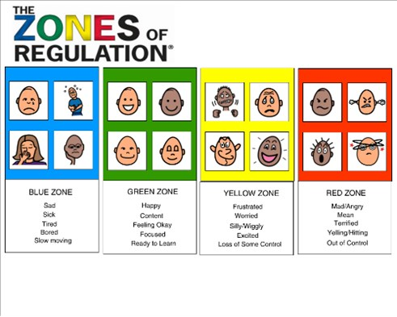
What are they?

Slide 3
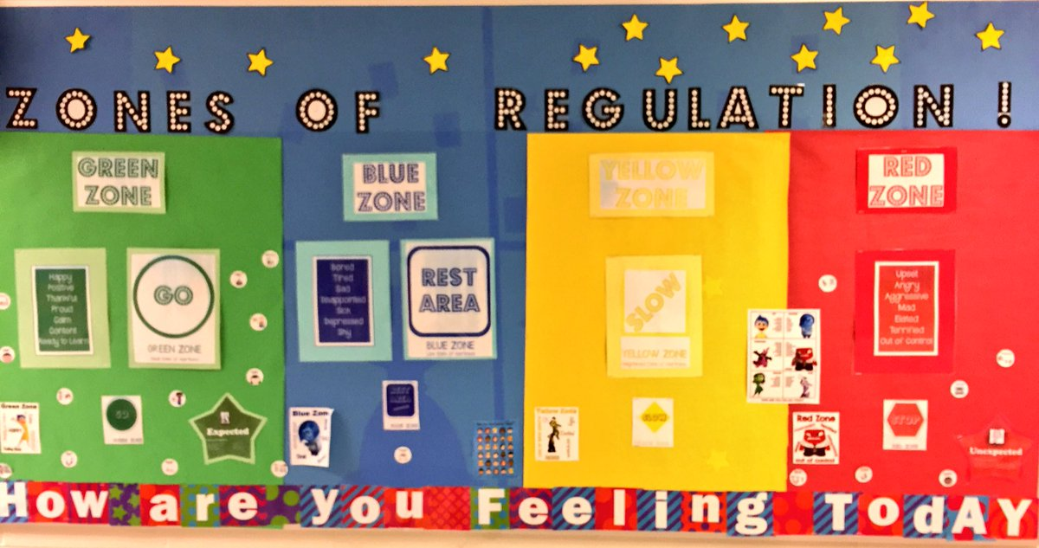
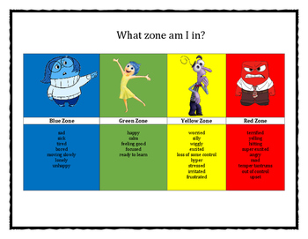
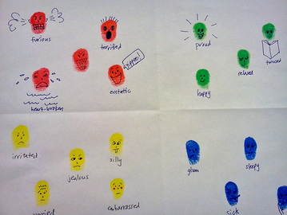
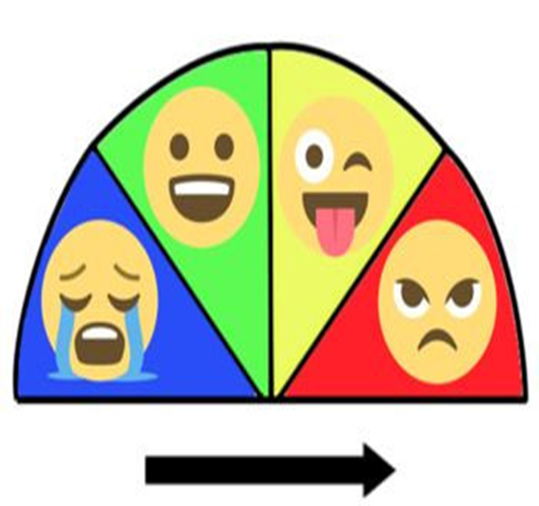
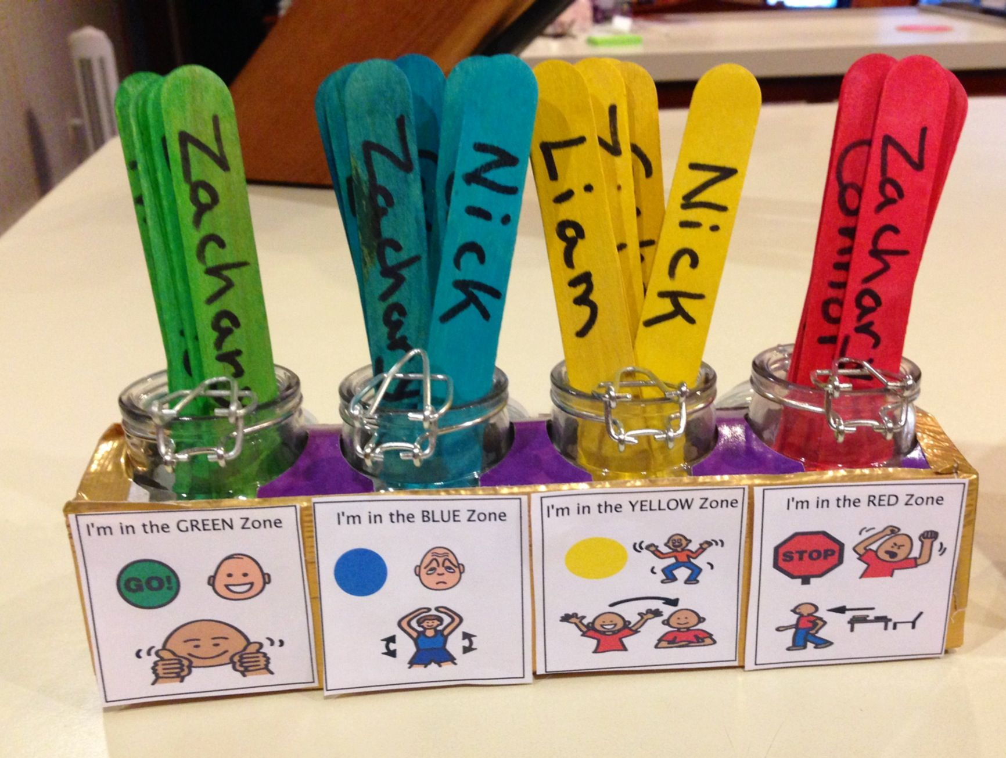

Slide 4
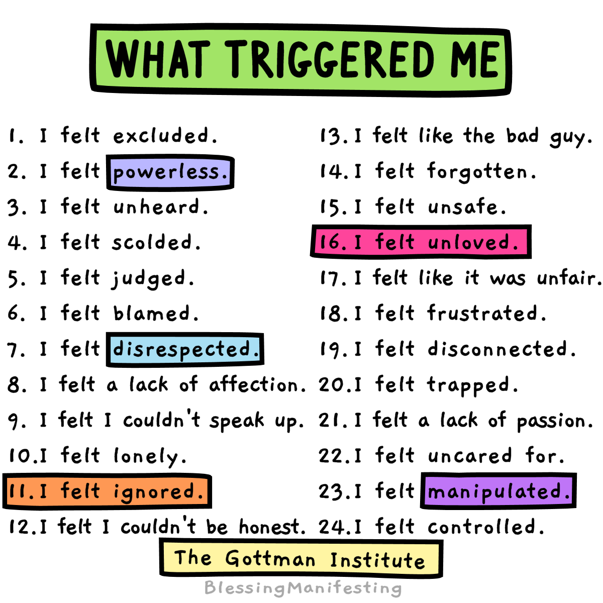
What made us feel this way?

Slide 5
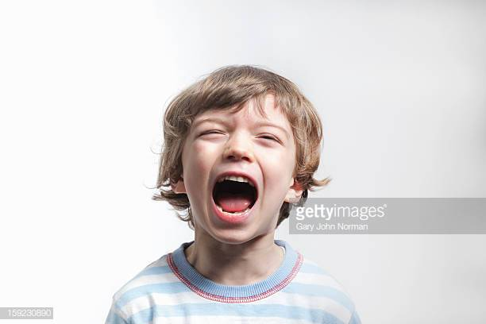


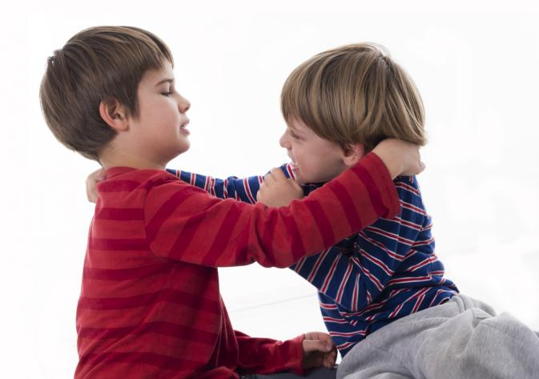
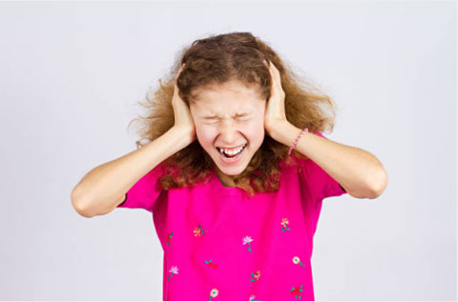

Unexpected behaviours

Slide 6
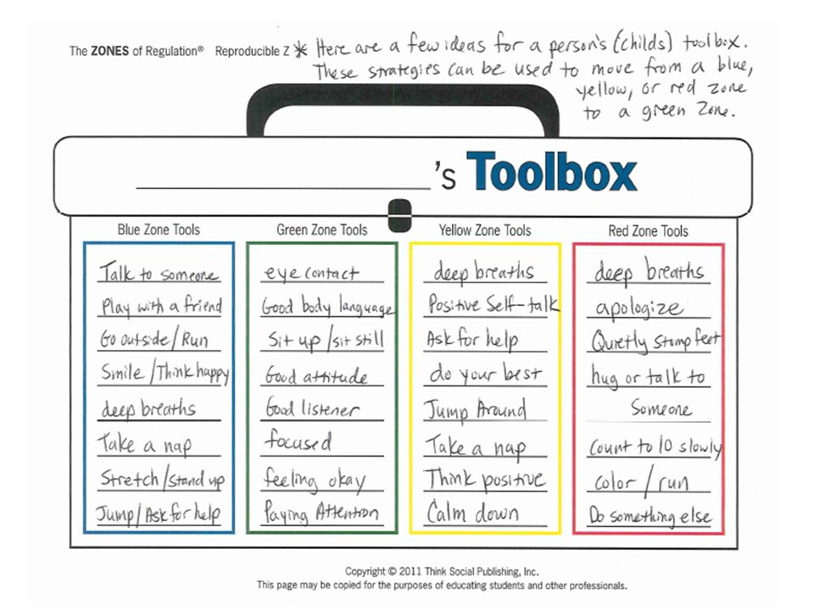

Slide 7

How can the zones help us?
We will learn that all emotions are OK!
Some are ‘not nice’ feelings but no feeling is ever bad.
It will help us to understand emotions in others. Which will
help us to help each other, when things aren’t going right.
We will start being able to use ‘tools’ to make us feel better
‘getting back to green’
We will learn what our triggers are and how to avoid them.

